Slide 1
St. Louis Central Corridor West Building Permits
Monthly Report: July 2020

Slide 2
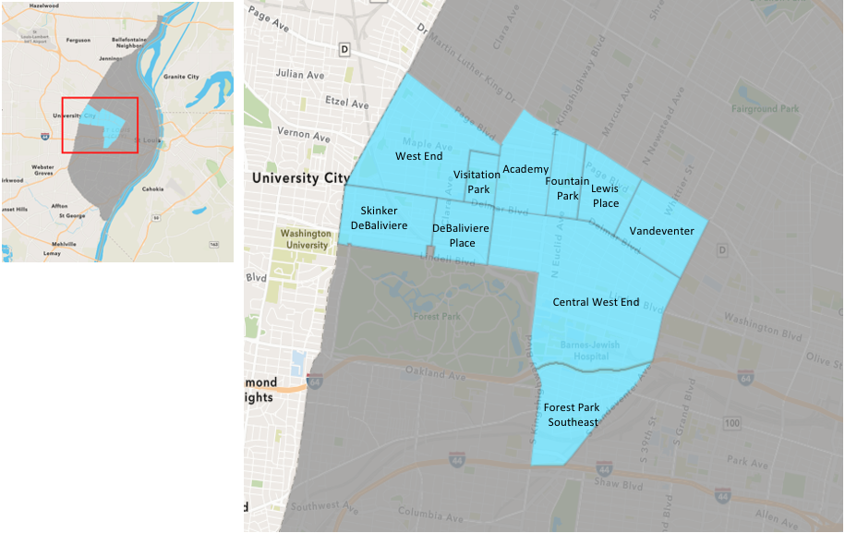
St. Louis Neighborhood Spatial Reference

Slide 3
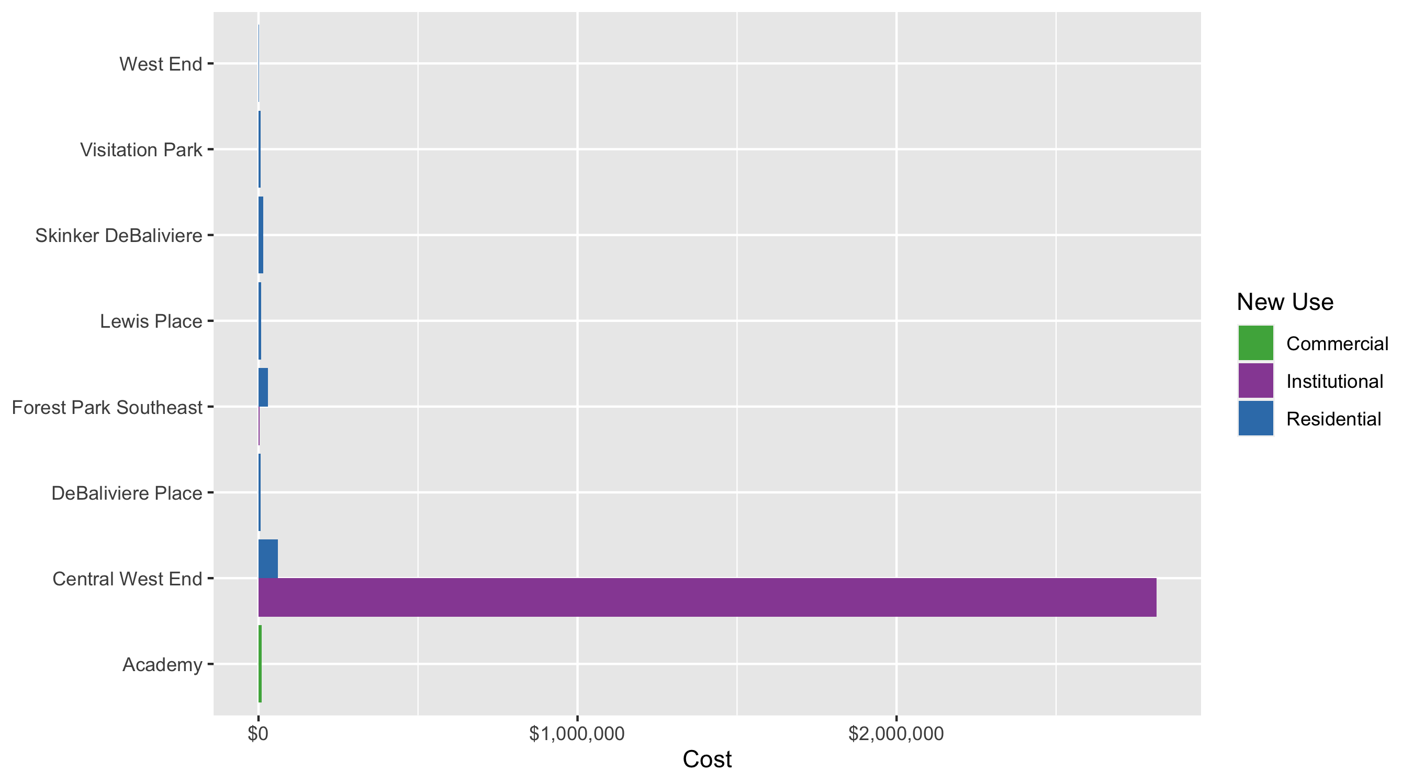
Neighborhood Summary: Average Building Permit Cost

Slide 4
Neighborhood Summary
July 2020 | July 2020 | July 2020 | July 2020
Neighborhood | Average Cost | # of Permits | Total Value of Permits
Academy | $10,000 | 1 | $10,000
Central West End | $1,590,671 | 18 | $28,632,074
DeBaliviere Place | $6,760 | 2 | $13,521
Forest Park Southeast | $16,735 | 4 | $66,940
Fountain Park | $0 | 0 | $0
Lewis Place | $8,000 | 1 | $8,000
Skinker DeBaliviere | $14,178 | 2 | $28,357
Vandeventer | $0 | 0 | $0
Visitation Park | $6,261 | 1 | $6,261
West End | $1,125 | 4 | $4,500
Last 6 Months | Last 6 Months | Last 6 Months | Last 6 Months
Neighborhood | Average Cost | # of Permits | Total Value of Permits
Academy | $41,465 | 17 | $704,900
Central West End | $420,558 | 193 | $81,167,780
DeBaliviere Place | $158,226 | 23 | $3,639,187
Forest Park Southeast | $114,080 | 51 | $5,818,055
Fountain Park | $58,357 | 7 | $408,500
Lewis Place | $2,175 | 4 | $8,700
Skinker DeBaliviere | $6,624,338 | 60 | $397,460,257
Vandeventer | $30,013 | 6 | $180,077
Visitation Park | $9,170 | 3 | $27,511
West End | $780,184 | 28 | $21,845,146

Slide 5
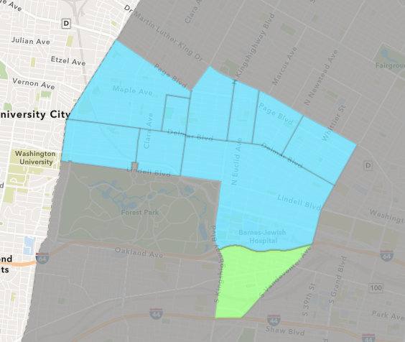
Forest Park Southeast
July 2020 Neighborhood Cost Breakdown
Mean: $16,735
Median: $3,220
Range: $500 - $60,000

Slide 6
Forest Park Southeast: Summary Notes
4 building permits in July 2020
-63.64% change compared to July 2019 (11 total building permits)
$16,735: Average building permit cost in July 2020
-83.92% change compared to July 2019 ($104,084)
60 total building permits in 2020
-39.39% change YTD compared to this time in 2019 (99 total building permits)
$106,070: YTD average building permit cost in 2020
-17.87% change YTD compared to this time in 2019 ($129,149)

Slide 7
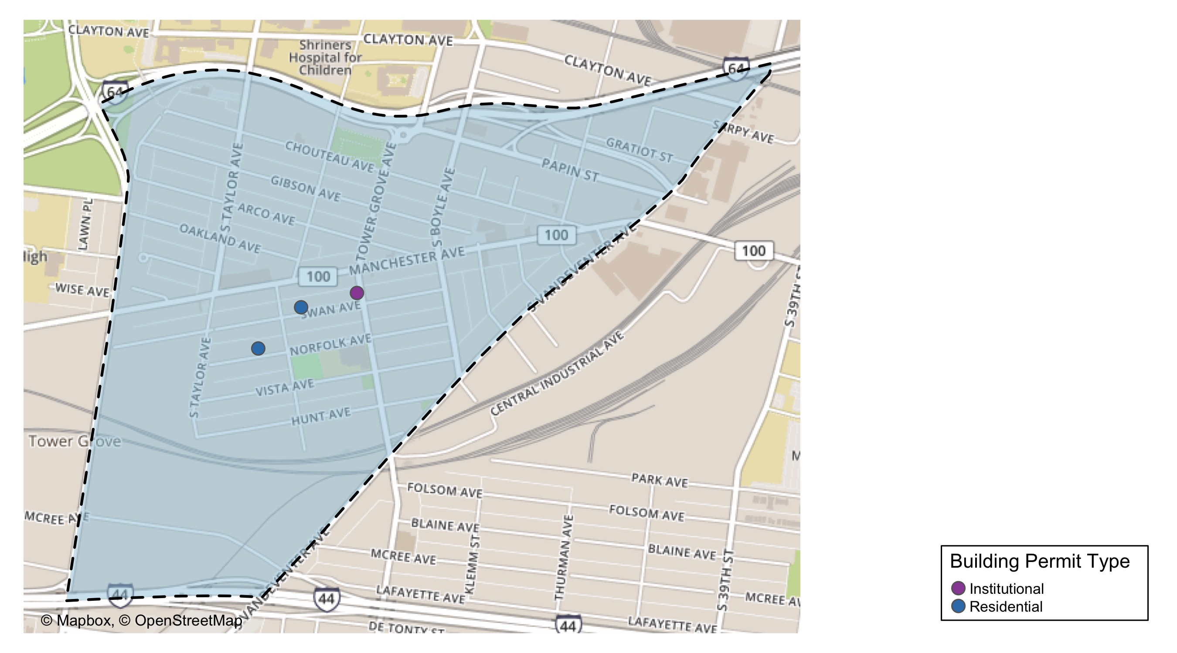
Forest Park Southeast

Slide 8
Neighborhood Summary
July 2020 | July 2020 | July 2020 | July 2020
Permit Use | Average Cost | # of Permits | Total Value of Permits
Commercial | $0 | 0 | $0
Industrial | $0 | 0 | $0
Institutional | $3,220 | 2 | $6,440
Residential | $30,250 | 2 | $60,500
Last 6 Months | Last 6 Months | Last 6 Months | Last 6 Months
Permit Use | Average Cost | # of Permits | Total Value of Permits
Commercial | $340,946 | 13 | $4,432,300
Industrial | $0 | 0 | $0
Institutional | $42,105 | 7 | $294,734
Residential | $35,194 | 31 | $1,091,021

Slide 9
Forest Park Southeast Individual Permit Breakdown
Owner | New Use | Cost | address
JORDAN, PHILIP M & KELSEY D | Residential | $500 | 4410-12 SWAN AV
LOWELL, ANNE K TRS | Residential | $60,000 | 4325-31 SWAN AV
WASHINGTON UNIVERSITY | Institutional | $5,440 | 1234 S KINGSHIGHWAY BLVD
PARK SOUTH PROPERTIES LLC | Institutional | $1,000 | 4366 MANCHESTER AV

Slide 10
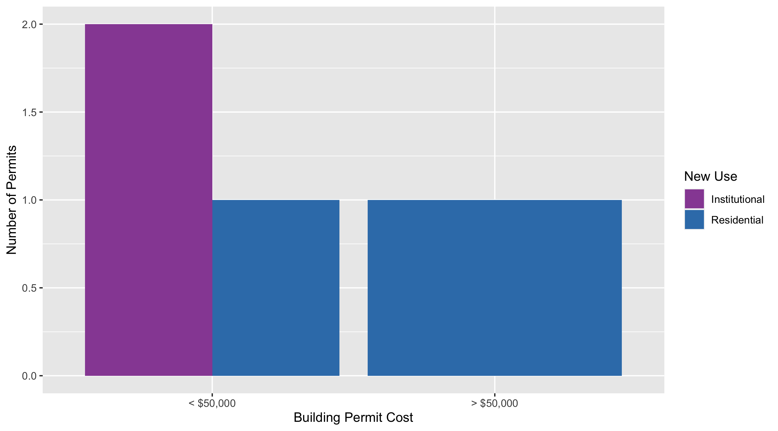
Forest Park Southeast Permit Cost Breakdown

Slide 11
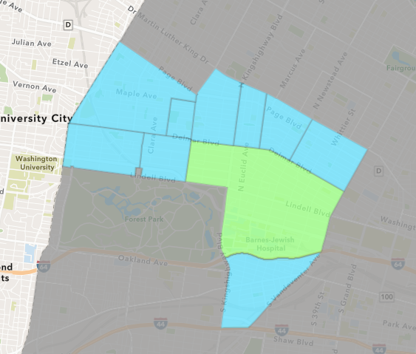
Central West End
July 2020 Neighborhood Cost Breakdown
Mean: $1,590,671
Median: $9,500
Range: $2,500 - $28,000,000

Slide 12
Central West End: Summary Notes
18 building permits in July 2020
-62.50% change compared to July 2019 (48 total building permits)
$1,590,671: Average building permit cost in July 2020
413.83% change compared to July 2019 ($309,573)
230 total building permits in 2020
-16.36% change YTD compared to this time in 2019 (275 total building permits)
$689,430: YTD average building permit cost in 2020
162.62% change YTD compared to this time in 2019 ($262,517)

Slide 13
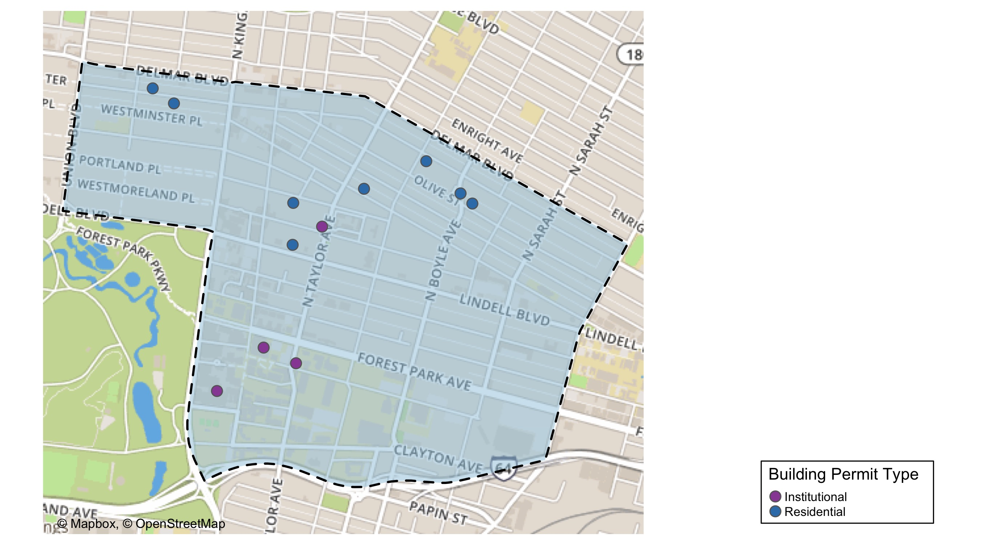
Central West End

Slide 14
Central West End
July 2020 | July 2020 | July 2020 | July 2020
Permit Use | Average Cost | # of Permits | Total Value of Permits
Commercial | $0 | 0 | $0
Industrial | $0 | 0 | $0
Institutional | $2,814,358 | 10 | $28,143,580
Residential | $61,062 | 8 | $488,494
Last 6 Months | Last 6 Months | Last 6 Months | Last 6 Months
Permit Use | Average Cost | # of Permits | Total Value of Permits
Commercial | $88,664 | 28 | $2,482,579
Industrial | $20,000 | 1 | $20,000
Institutional | $526,704 | 64 | $33,709,054
Residential | $449,561 | 100 | $44,956,147

Slide 15
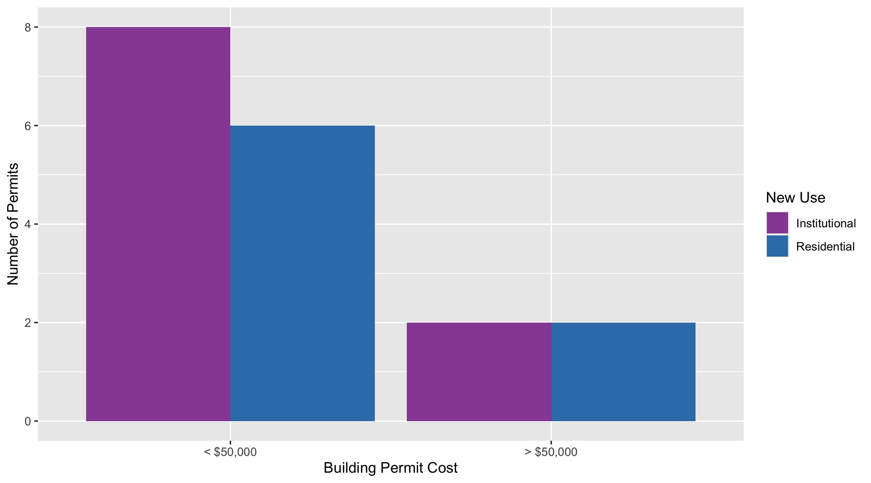
Cental West End Permit Cost Breakdown

Slide 16
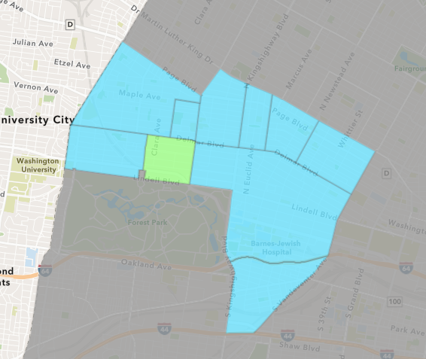
DeBaliviere Place
July 2020 Neighborhood Cost Breakdown
Mean: $6,760
Median: $6,760
Range: $5,000 - $8,521

Slide 17
DeBaliviere Place: Summary Notes
2 building permits in July 2020
-66.67% change compared to July 2019 (6 total building permits)
$6,760: Average building permit cost in July 2020
-78.03% change compared to July 2019 ($30,767)
26 total building permits in 2020
-29.73% change YTD compared to this time in 2019 (37 total building permits)
$833,815: YTD average building permit cost in 2020
1372.12% change YTD compared to this time in 2019 ($56,640)

Slide 18
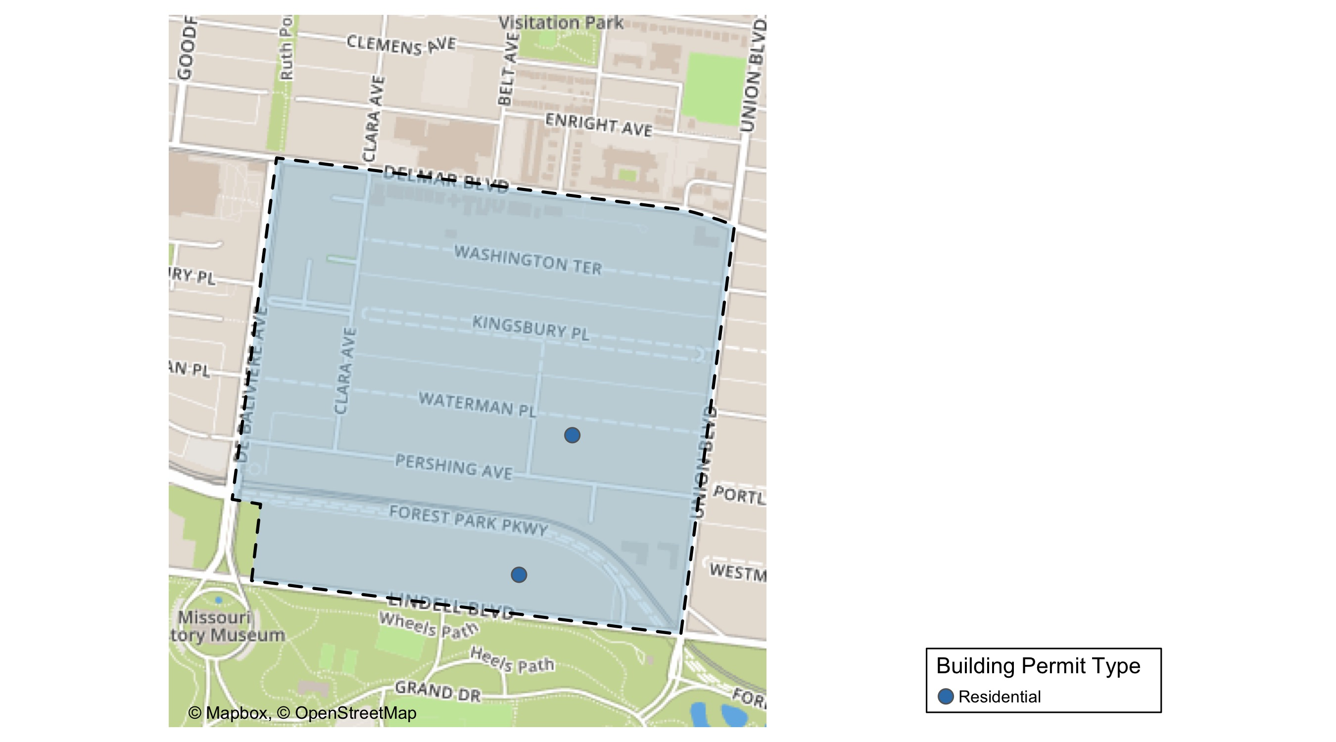
DeBaliviere Place

Slide 19
DeBaliviere Place
July 2020 | July 2020 | July 2020 | July 2020
Permit Use | Average Cost | # of Permits | Total Value of Permits
Commercial | $0 | 0 | $0
Industrial | $0 | 0 | $0
Institutional | $0 | 0 | $0
Residential | $6,760 | 2 | $13,521
Last 6 Months | Last 6 Months | Last 6 Months | Last 6 Months
Permit Use | Average Cost | # of Permits | Total Value of Permits
Commercial | $25,000 | 1 | $25,000
Industrial | $0 | 0 | $0
Institutional | $0 | 0 | $0
Residential | $164,281 | 22 | $3,614,187

Slide 20
DeBaliviere Place Individual Permit Breakdown
Owner | New Use | Cost | Address
JONES, COURTNEY A & TRITOBIA Q | Residential | $5,000 | 5357 LINDELL BLVD
DOMINICAN COMM OF ST L | Residential | $8,521 | 97 WATERMAN PL

Slide 21
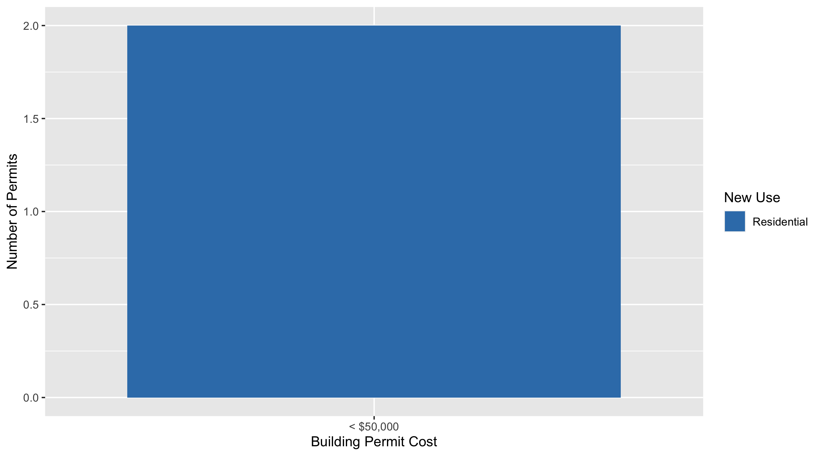
DeBaliviere Place Permit Cost Breakdown

Slide 22
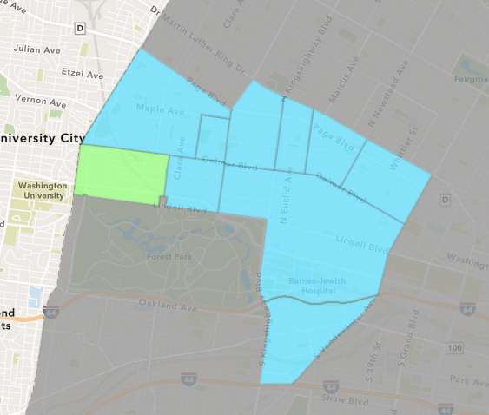
Skinker DeBaliviere
July 2020 Neighborhood Cost Breakdown
Mean: $14,178
Median: $14,178
Range: $10,000 - $18,357

Slide 23
Skinker DeBaliviere: Summary Notes
2 building permits in July 2020
-50.00% change compared to July 2019 (4 total building permits)
$14,178: Average building permit cost in July 2020
0.38% change compared to July 2019 ($14,125)
67 total building permits in 2020
91.43% change YTD compared to this time in 2019 (35 total building permits)
$5,935,123: YTD average building permit cost in 2020
38260.98% change YTD compared to this time in 2019 ($15,472)

Slide 24
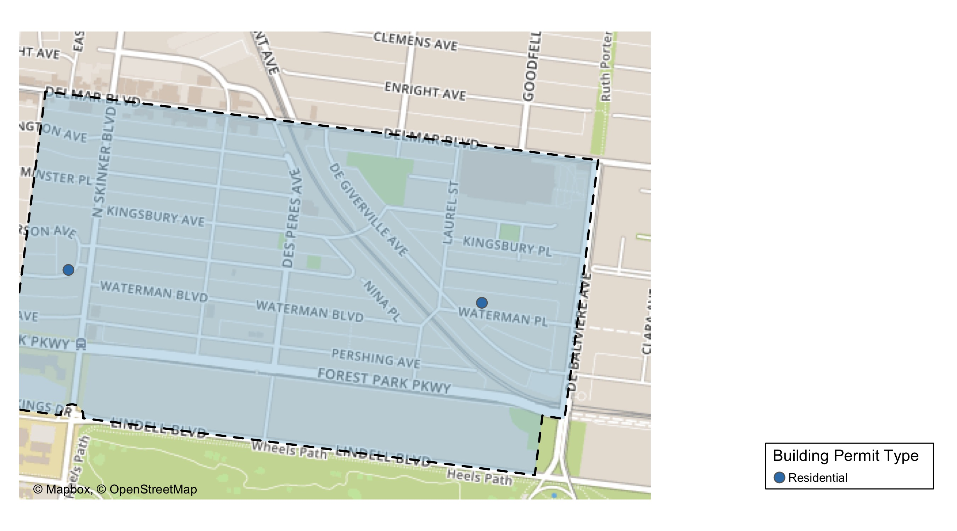
Skinker DeBaliviere

Slide 25
Skinker DeBaliviere
July 2020 | July 2020 | July 2020 | July 2020
Permit Use | Average Cost | # of Permits | Total Value of Permits
Commercial | $0 | 0 | $0
Industrial | $0 | 0 | $0
Institutional | $0 | 0 | $0
Residential | $14,178 | 2 | $28,357
Last 6 Months | Last 6 Months | Last 6 Months | Last 6 Months
Permit Use | Average Cost | # of Permits | Total Value of Permits
Commercial | $56,185,283 | 7 | $393,296,978
Industrial | $0 | 0 | $0
Institutional | $0 | 0 | $0
Residential | $78,552 | 53 | $4,163,279

Slide 26
Skinker DeBaliviere Individual Permit Breakdown
Owner | New Use | Cost | Address
GIAIMO, CHRISTOPHER & | Residential | $18,357 | 6210 WESTMINSTER PL
MCLAREN, MARK P & KE KAY MASCHEK | Residential | $10,000 | 5731 WATERMAN BLVD

Slide 27
Skinker DeBaliviere Permit Cost Breakdown

Slide 28
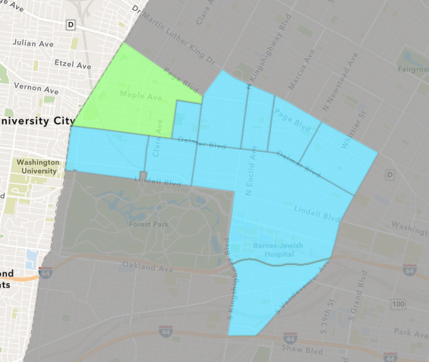
West End
July 2020 Neighborhood Cost Breakdown
Mean: $1,125
Median: $950
Range: $600 - $2,000

Slide 29
West End: Summary Notes
4 building permits in July 2020
0.00% change compared to July 2019 (4 total building permits)
$1,125: Average building permit cost in July 2020
-99.75% change compared to July 2019 ($453,029)
38 total building permits in 2020
80.95% change YTD compared to this time in 2019 (21 total building permits)
$576,978: YTD average building permit cost in 2020
200.67% change YTD compared to this time in 2019 ($191,896)

Slide 30
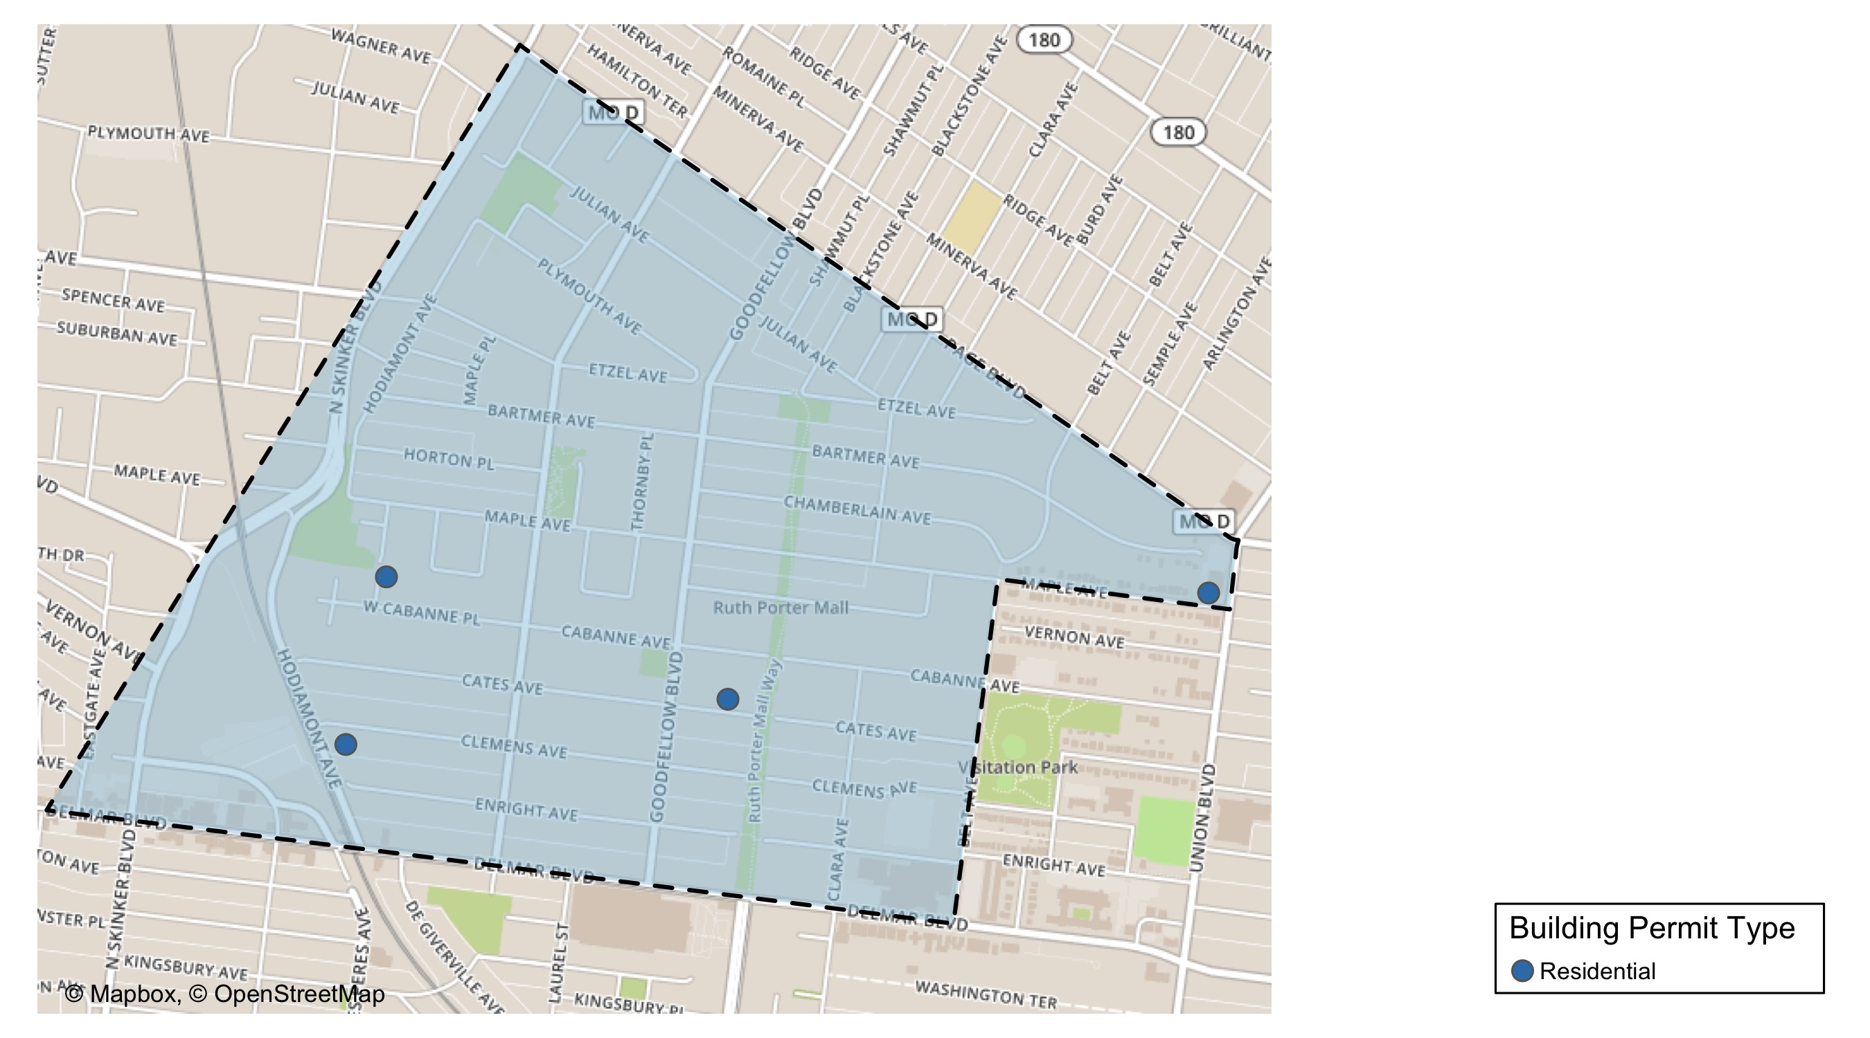
West End

Slide 31
West End
July 2020 | July 2020 | July 2020 | July 2020
Permit Use | Average Cost | # of Permits | Total Value of Permits
Commercial | $0 | 0 | $0
Industrial | $0 | 0 | $0
Institutional | $0 | 0 | $0
Residential | $1,125 | 4 | $4,500
Last 6 Months | Last 6 Months | Last 6 Months | Last 6 Months
Permit Use | Average Cost | # of Permits | Total Value of Permits
Commercial | $100,138 | 4 | $400,550
Industrial | $0 | 0 | $0
Institutional | $3,228,000 | 3 | $9,684,000
Residential | $560,028 | 21 | $11,760,596

Slide 32
West End Individual Permit Breakdown
Owner | New Use | Cost | Address
MCGEE, JEFFREY L & ACADIA N | Residential | $900 | 6033 CLEMENS AV
BROOKS, TRAVIOUS | Residential | $600 | 5414 BARTMER AV
SUTTON, DARRION E | Residential | $2,000 | 5705 CATES AV
HARDIN, JEFFREY & TIFFANY | Residential | $1,000 | 5941 WEST CABANNE PL

Slide 33
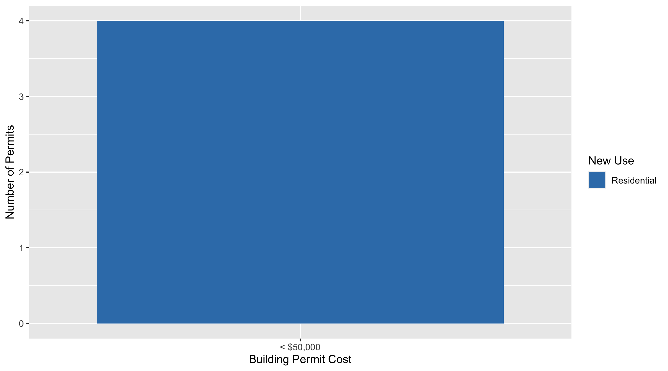
West End Permit Cost Breakdown

Slide 34
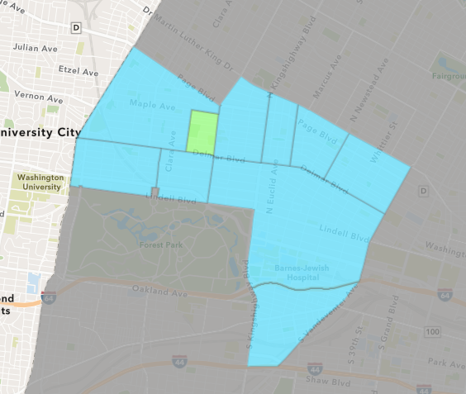
Visitation Park
July 2020 Neighborhood Cost Breakdown
Mean: $6,261
Median: $6,261
Range: $6,261 - $6,261

Slide 35
Visitation Park: Summary Notes
1 building permits in July 2020
Infinite change compared to July 2019 (0 total building permits)
$6,261: Average building permit cost in July 2020
Infinite change compared to July 2019 ($0)
3 total building permits in 2020
Infinite change YTD compared to this time in 2019 (0 total building permits)
$9,170: YTD average building permit cost in 2020
Infinite change YTD compared to this time in 2019 ($0)

Slide 36
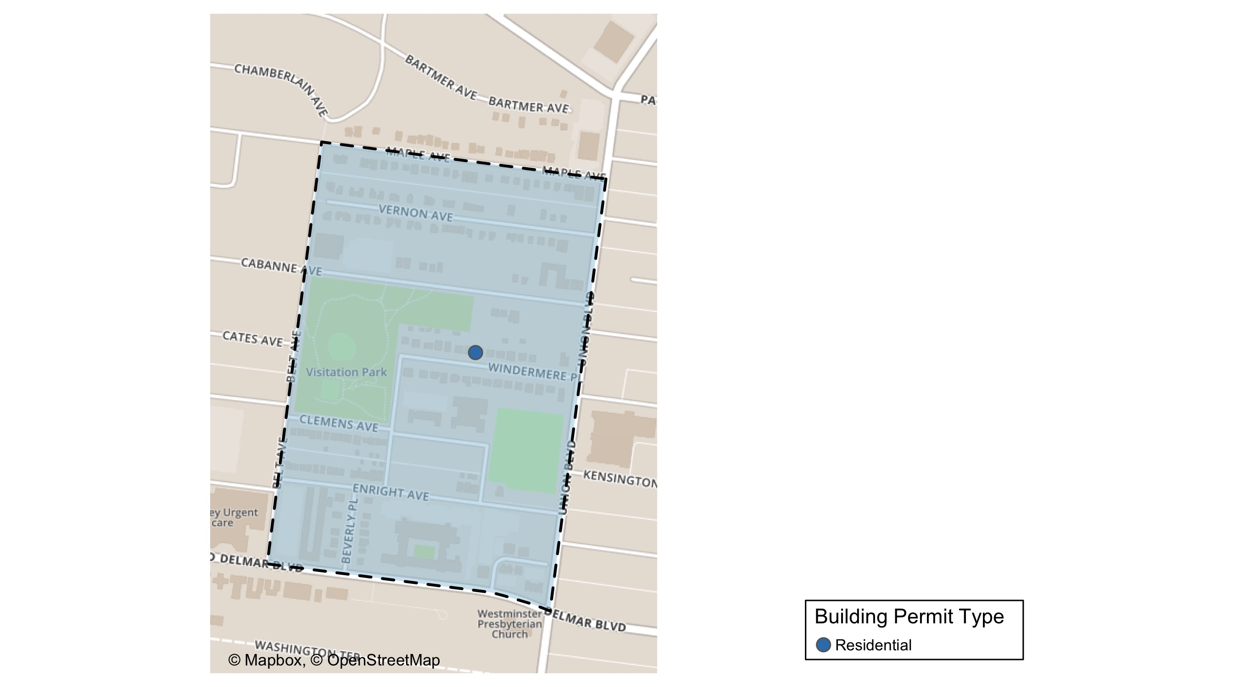
Visitation Park

Slide 37
Visitation Park
July 2020 | July 2020 | July 2020 | July 2020
Permit Use | Average Cost | # of Permits | Total Value of Permits
Commercial | $0 | 0 | $0
Industrial | $0 | 0 | $0
Institutional | $0 | 0 | $0
Residential | $6,261 | 1 | $6,261
Last 6 Months | Last 6 Months | Last 6 Months | Last 6 Months
Permit Use | Average Cost | # of Permits | Total Value of Permits
Commercial | $0 | 0 | $0
Industrial | $0 | 0 | $0
Institutional | $0 | 0 | $0
Residential | $9,170 | 3 | $27,511

Slide 38
Visitation Park Individual Permit Breakdown
Owner | New Use | Cost | Address
MONTGOMERY, JUDY TRS | Residential | $6,261 | 13 WINDERMERE PL

Slide 39
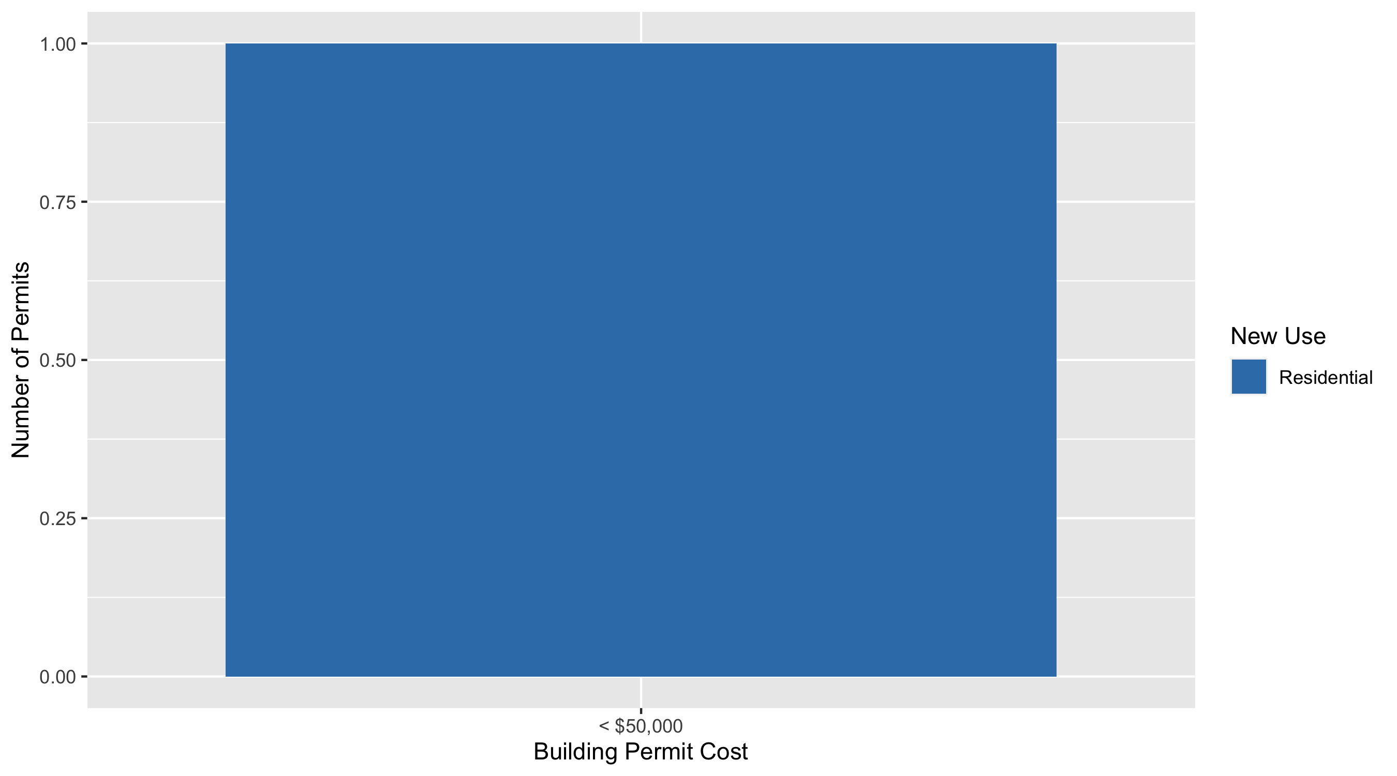
Visitation Park Permit Cost Breakdown

Slide 40
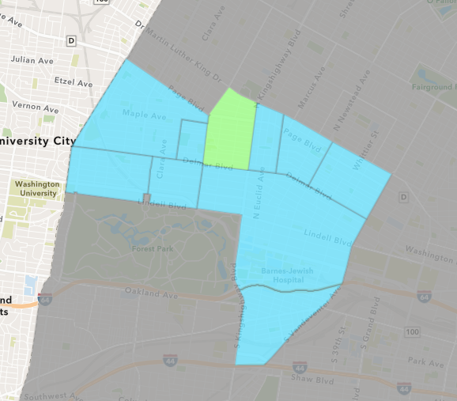
Academy
July 2020 Neighborhood Cost Breakdown
Mean: $10,000
Median: $10,000
Range: $10,000 - $10,000

Slide 41
Academy: Summary Notes
1 building permits in July 2020
0.00% change compared to July 2019 (1 total building permits)
$10,000: Average building permit cost in July 2020
-95.00% change compared to July 2019 ($200,000)
23 total building permits in 2020
21.05% change YTD compared to this time in 2019 (19 total building permits)
$53,037: YTD average building permit cost in 2020
-26.56% change YTD compared to this time in 2019 ($72,221)

Slide 42
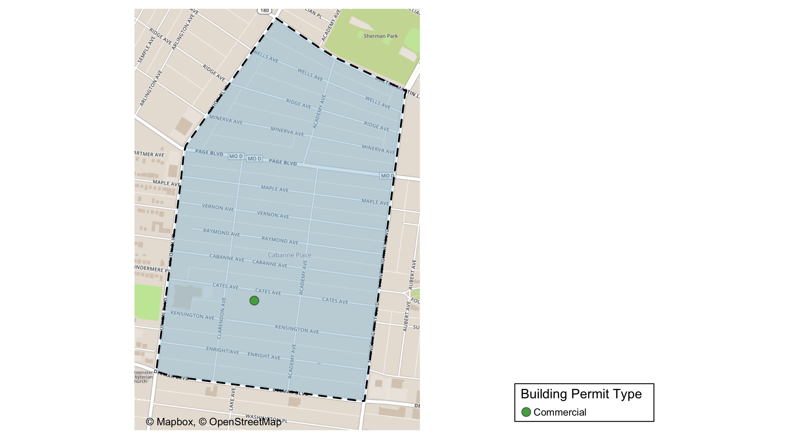
Academy

Slide 43
Academy
July 2020 | July 2020 | July 2020 | July 2020
Permit Use | Average Cost | # of Permits | Total Value of Permits
Commercial | $10,000 | 1 | $10,000
Industrial | $0 | 0 | $0
Institutional | $0 | 0 | $0
Residential | $0 | 0 | $0
Last 6 Months | Last 6 Months | Last 6 Months | Last 6 Months
Permit Use | Average Cost | # of Permits | Total Value of Permits
Commercial | $10,000 | 1 | $10,000
Industrial | $0 | 0 | $0
Institutional | $50,000 | 1 | $50,000
Residential | $42,993 | 15 | $644,900

Slide 44
Academy Individual Permit Breakdown
Owner | New Use | Cost | Address
BINGHAM, JEFFREY | Commercial | $10,000 | 5179 CATES AV

Slide 45
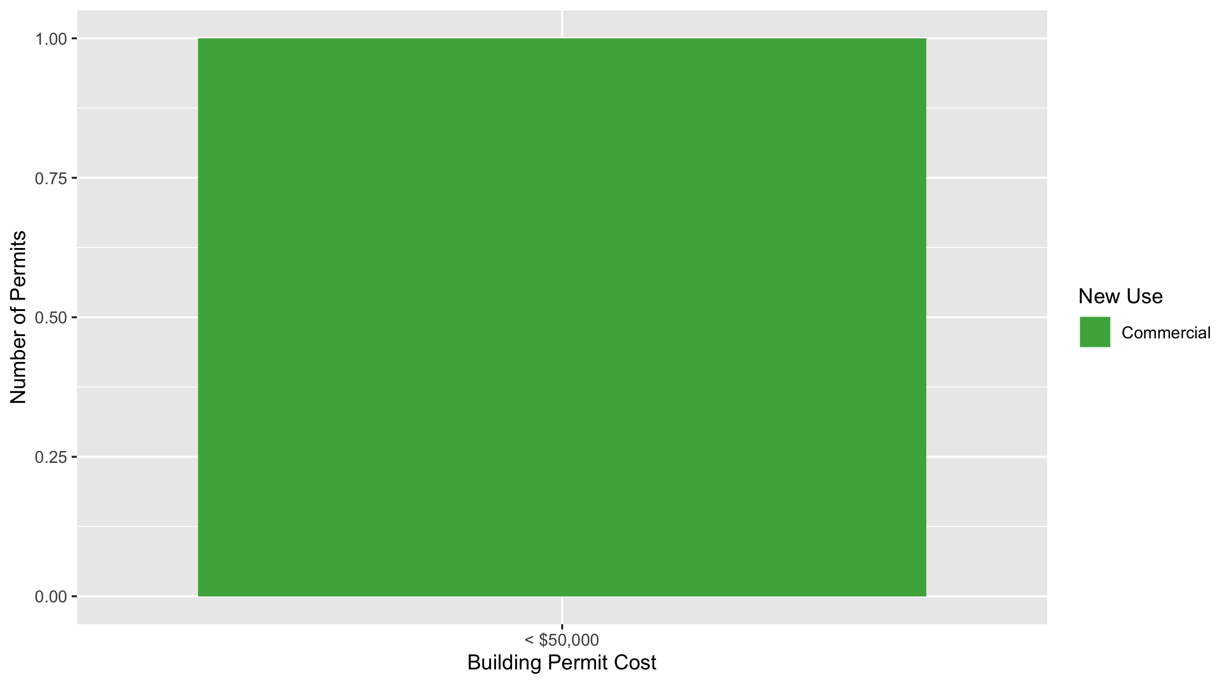
Academy Permit Cost Breakdown

Slide 46
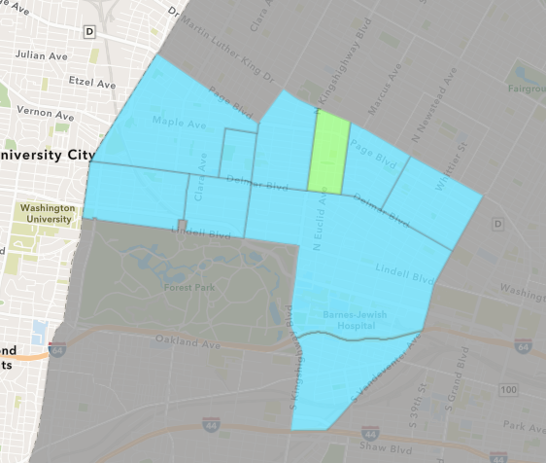
Fountain Park
July 2020 Neighborhood Cost Breakdown
Mean: $0
Median: NA
Range: $0 - $0

Slide 47
Fountain Park: Summary Notes
0 building permits in July 2020
-100.00% change compared to July 2019 (1 total building permits)
$0: Average building permit cost in July 2020
-100.00% change compared to July 2019 ($100,000)
7 total building permits in 2020
40.00% change YTD compared to this time in 2019 (5 total building permits)
$58,357: YTD average building permit cost in 2020
24.96% change YTD compared to this time in 2019 ($46,700)

Slide 48
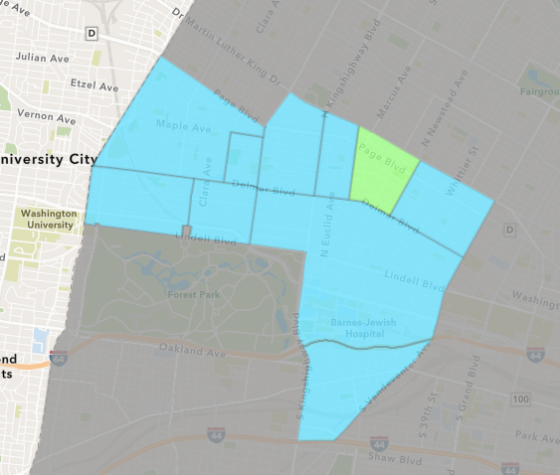
Lewis Place
July 2020 Neighborhood Cost Breakdown
Mean: $8,000
Median: $8,000
Range: $8,000 - $8,000

Slide 49
Lewis Place: Summary Notes
1 building permits in July 2020
Infinite change compared to July 2019 (0 total building permits)
$8,000: Average building permit cost in July 2020
Infinite change compared to July 2019 ($0)
5 total building permits in 2020
-16.67% change YTD compared to this time in 2019 (6 total building permits)
$2,240: YTD average building permit cost in 2020
-67.30% change YTD compared to this time in 2019 ($6,850)

Slide 50
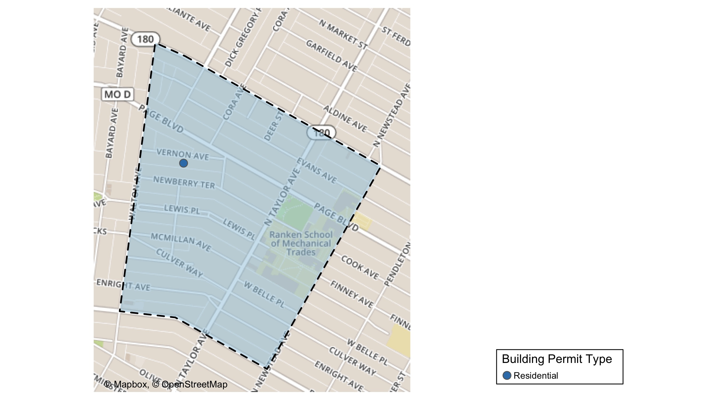
Lewis Place

Slide 51
Lewis Place
July 2020 | July 2020 | July 2020 | July 2020
Permit Use | Average Cost | # of Permits | Total Value of Permits
Commercial | $0 | 0 | $0
Industrial | $0 | 0 | $0
Institutional | $0 | 0 | $0
Residential | $8,000 | 1 | $8,000
Last 6 Months | Last 6 Months | Last 6 Months | Last 6 Months
Permit Use | Average Cost | # of Permits | Total Value of Permits
Commercial | $100 | 2 | $200
Industrial | $0 | 0 | $0
Institutional | $0 | 0 | $0
Residential | $4,250 | 2 | $8,500

Slide 52
Lewis Place Individual Permit Breakdown
Owner | New Use | Cost | Address
THOMAS, KEITH, MARVIN THOMAS, TEVEN | Residential | $8,000 | 4708 VERNON AV

Slide 53
Lewis Place Permit Cost Breakdown

Slide 54
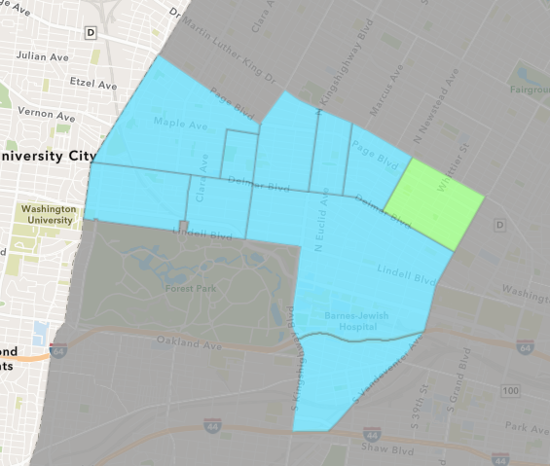
Vandeventer
July 2020 Neighborhood Cost Breakdown
Mean: $0
Median: NA
Range: $0 - $0

Slide 55
Vandeventer: Summary Notes
0 building permits in July 2020
-100.00% change compared to July 2019 (3 total building permits)
$0: Average building permit cost in July 2020
-100.00% change compared to July 2019 ($1,533)
8 total building permits in 2020
-63.64% change YTD compared to this time in 2019 (22 total building permits)
$48,135: YTD average building permit cost in 2020
-65.35% change YTD compared to this time in 2019 ($138,911)

Slide 56
Additional Notes
Data retreived from https://www.stlouis-mo.gov/data/
Building permits with a cost of $0 were dropped
Building permits that were cancelled were dropped
Infinite change indicates 0 permits in the current or previous time period/comparison month so there was a overall increase or decrease

